Slide 1


Introduction to .NET MAUI
James Montemagno
Principal Lead PM – Developer Community, Microsoft
@JamesMontemagno
/JamesMontemagno

Slide 2
Agenda
Introduction to .NET MAUI
Building our First App
MVVM & Data Binding
Navigation
Accessing Platform Functionality
Displaying Data
App Themes

Slide 3
Machine Setup

Slide 4
Code & Walkthrough aka.ms/maui-workshop

Slide 5
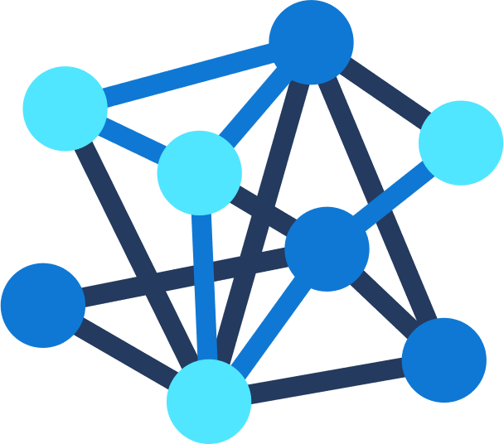







.NET – A unified development platform
ECOSYSTEM
TOOLS
CLOUD
WEB
MOBILE
GAMING
IoT
AI
NuGet
Visual Studio
DESKTOP
Azure
ASP.NET
Blazor
.NET MAUI
WPF
WinForms
.NET MAUI
Xamarin
Unity
ARM32
ARM64
ML.NET
.NET for Apache Spark
GitHub
Visual Studio for Mac
.NET 6
COMMON BASE LIBARIES/APIs
Components, tools, library vendors
Visual Studio Code
INFRASTRUCTURE
RUNTIME COMPONENTS
COMPILERS
LANGUAGES
CLI

Slide 6










Slide 7


Slide 8
An open-source app platform
from Microsoft for building
modern, performant, & multi-platform
iOS, Android, macOS, & Windows apps
with C# and .NET from a
single shared codebase.

Slide 9




Productive environment
Maximize code reuse
Native performance & integrations
Expansive ecosystem

Slide 10

.NET MAUI App Architecture
C#
C#
C#
C#
Shared Code
UI, Resources, Platform Features, & Business Logic

Slide 11
Cross-Platform UI

Slide 12

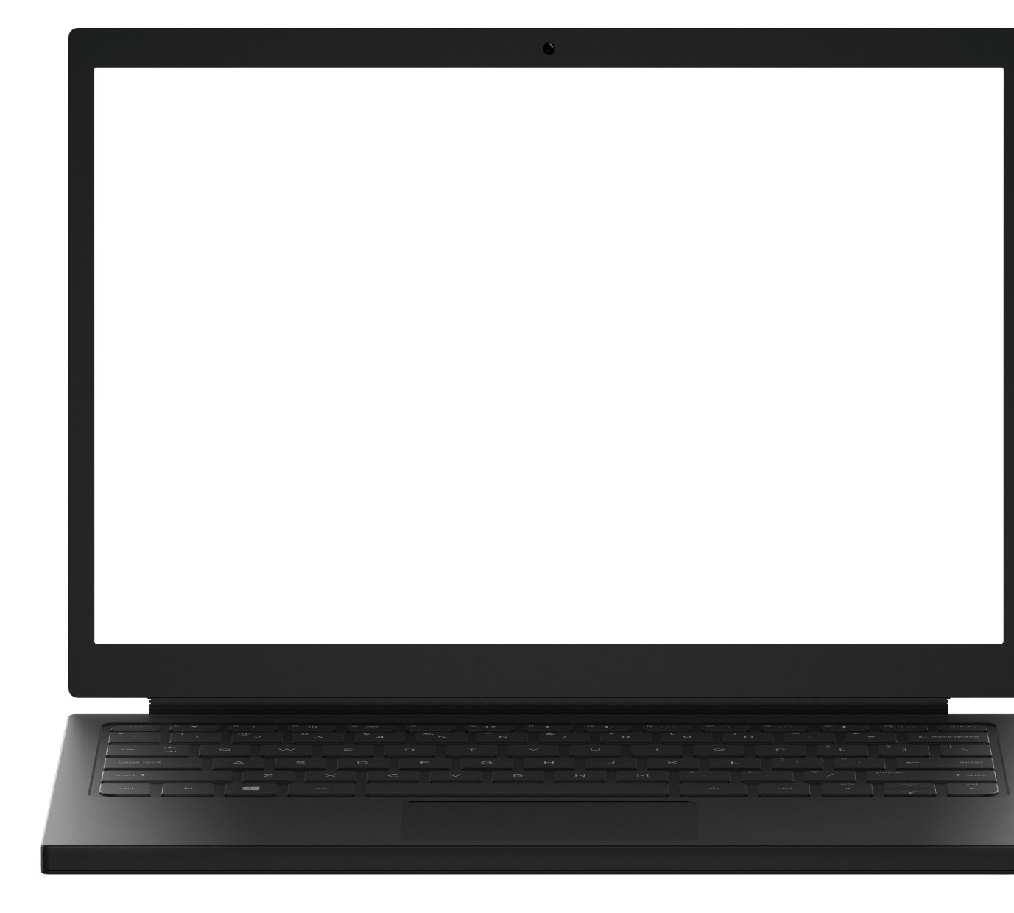
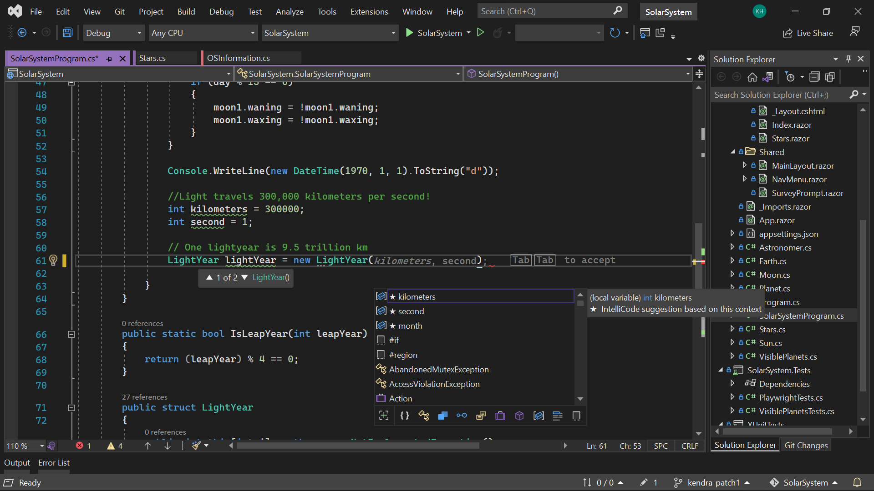
Visual Studio 2022
Modern development
Build innovative, modern apps using .NET 6, GitHub and Azure with integrated tooling
Personal and team productivity
Live Share, Hot reload everywhere, Web live preview, IntelliCode, enhanced debugging and testing tools
Scale to projects of any size
An optimized, modern UI built on 64-bit architecture to support the largest, most complex codebases and workflows
VisualStudio.com/download

Slide 13

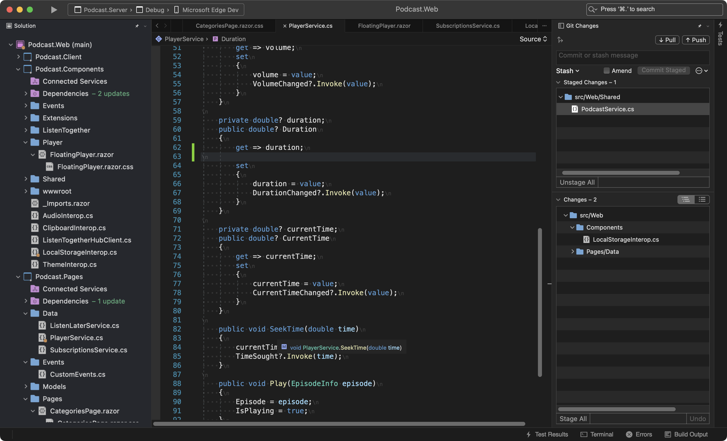
Visual Studio 2022 for Mac
Fast and Fluid
Focused on performance with over 100 user reported issues fixed; running on .NET 6 and with native support for Apple’s M1 processor
Modern macOS UI
A rewritten UI, using native macOS Cocoa APIs. With native theming, full screen support, and macOS accessibility tooling.
Support for .NET 6
Build for the web, cloud, and (soon) mobile, using .NET 6.
https://aka.ms/vsmac-preview

Slide 14




UIActivityIndicator
ProgressBar
UISlider
SeekBar
ActivityIndicator
Slider

Slide 15
Controls
CarouselView
CollectionView
ListView
Picker
TableView
IndicatorView
ProgressBar
ActivityIndicator
Editor
Entry
CheckBox
DatePicker
Slider
Stepper
Switch
TimePicker
Button
ImageButton
RadioButton
RefreshView
SearchBar
SwipeView
BlazorWebview
Border
BoxView
Frame
GraphicsView
Image
Label
ScrollView

Slide 16

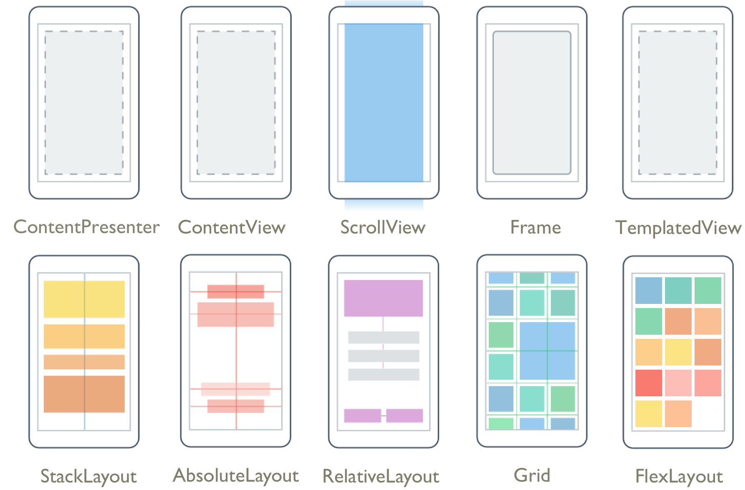
Layouts
Pages
Content
Flyout
Navigation
Tabbed

Slide 17
Platform API Access

Slide 18
iOS
MapKit
UIKit
SiriKit
ARKit
CoreML
System.Net
System
System.IO
System.Linq
System.Xml
System.Data
System.Windows
System.Numerics
System.Core
System.ServiceModel
C#

Slide 19
Android
Fingerprint
Bluetooth
Picture-in-Picture
Geolocation
NFC
System.Net
System
System.IO
System.Linq
System.Xml
System.Data
System.Windows
System.Numerics
System.Core
System.ServiceModel
C#

Slide 20

Maui.Essentials
Sms
Secure Settings
Preferences
Flashlight
Clipboard
Gyroscope
Magnetometer
Geolocation
Phone Dialer
Device Display Info
Email
Device Info
Battery
Compass
Accelerometer
Screen Lock
Data Transfer
Text to Speech
Geocoding
File System
Connectivity
Vibration

Slide 21
Geolocation Example
// Get cached location, else get real location.
var location = await Geolocation.GetLastKnownLocationAsync();
if (location == null)
{
location = await Geolocation.GetLocationAsync(new GeolocationRequest
{
DesiredAccuracy = GeolocationAccuracy.Medium,
Timeout = TimeSpan.FromSeconds(30)
});
}

Slide 22
Geolocation Example
// Register service
builder.Services.AddSingleton<IGeolocation, GeolocationImplementation>();
// Inject service
IGeolocation geolocation;
public MyViewModel(IGeolocation geolocation)
{
this.geolocation = geolocation;
}

Slide 23
Performance

Slide 24
Built on trusted technology
ARM BINARY
IL + JIT
.NET
.NET
AOT
.APP
Compile and Link
.APK
C#
C#
Runs natively
Runs natively
Bindings
Bindings
.NET for iOS does full Ahead Of Time (AOT) compilation to produce an ARM binary for Apple’s App Store.
.NET for Android takes advantage of Just In Time (JIT) & Ahead of Time (AOT) compilation on the Android device.

Slide 25
Full App Platform
✓ 40+ Pages, layouts, and controls
(Build from C# or XAML)
✓ Two-way data binding
✓ Navigation
✓ Visual State Manager
✓ Animation API
✓ Dependency Service
✓ Messaging Center
✓ CI/CD Support
✓ Hybrid Development with Blazor
✓ Platform API Access
✓ Images, Icons, Fonts, Splash Screens
✓ Custom & Default Themes
C#
C#
C#
C#
Shared Code
UI, Resources, Platform Features, & Business Logic

Slide 26


.NET MAUI Ecosystem

Slide 27
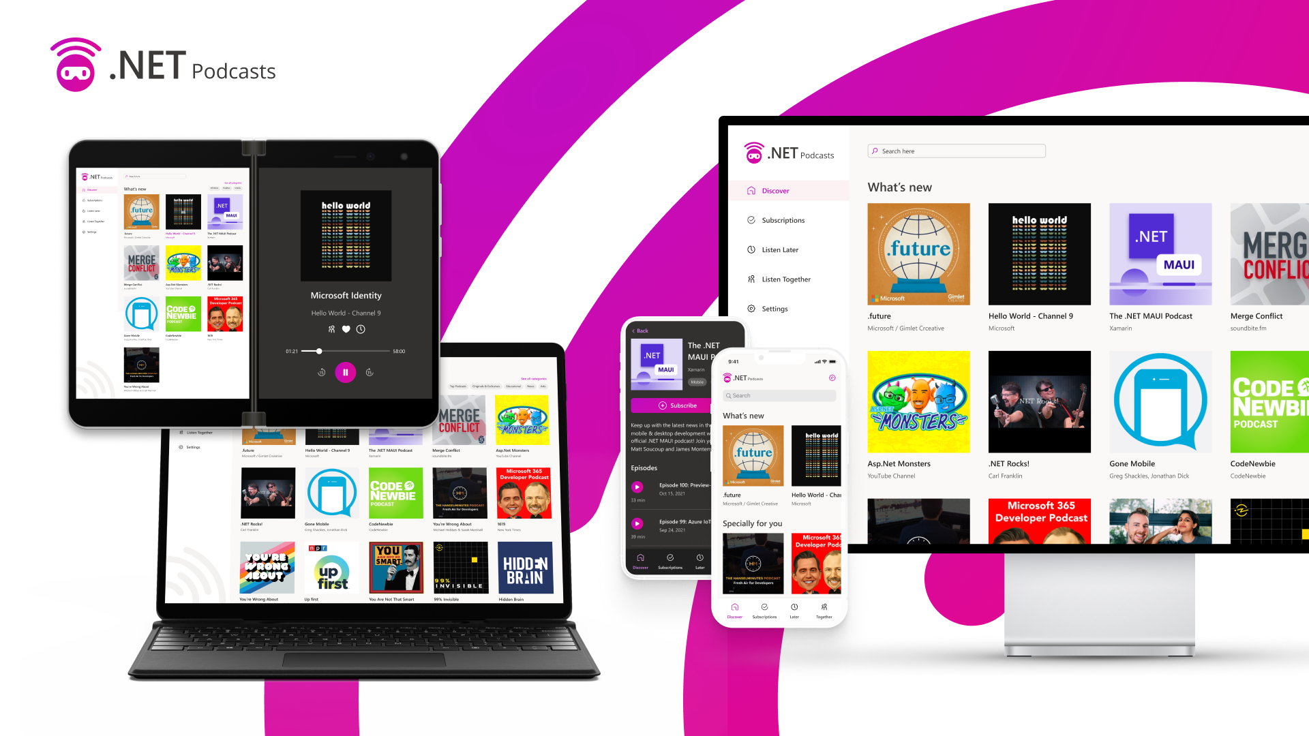

Slide 28
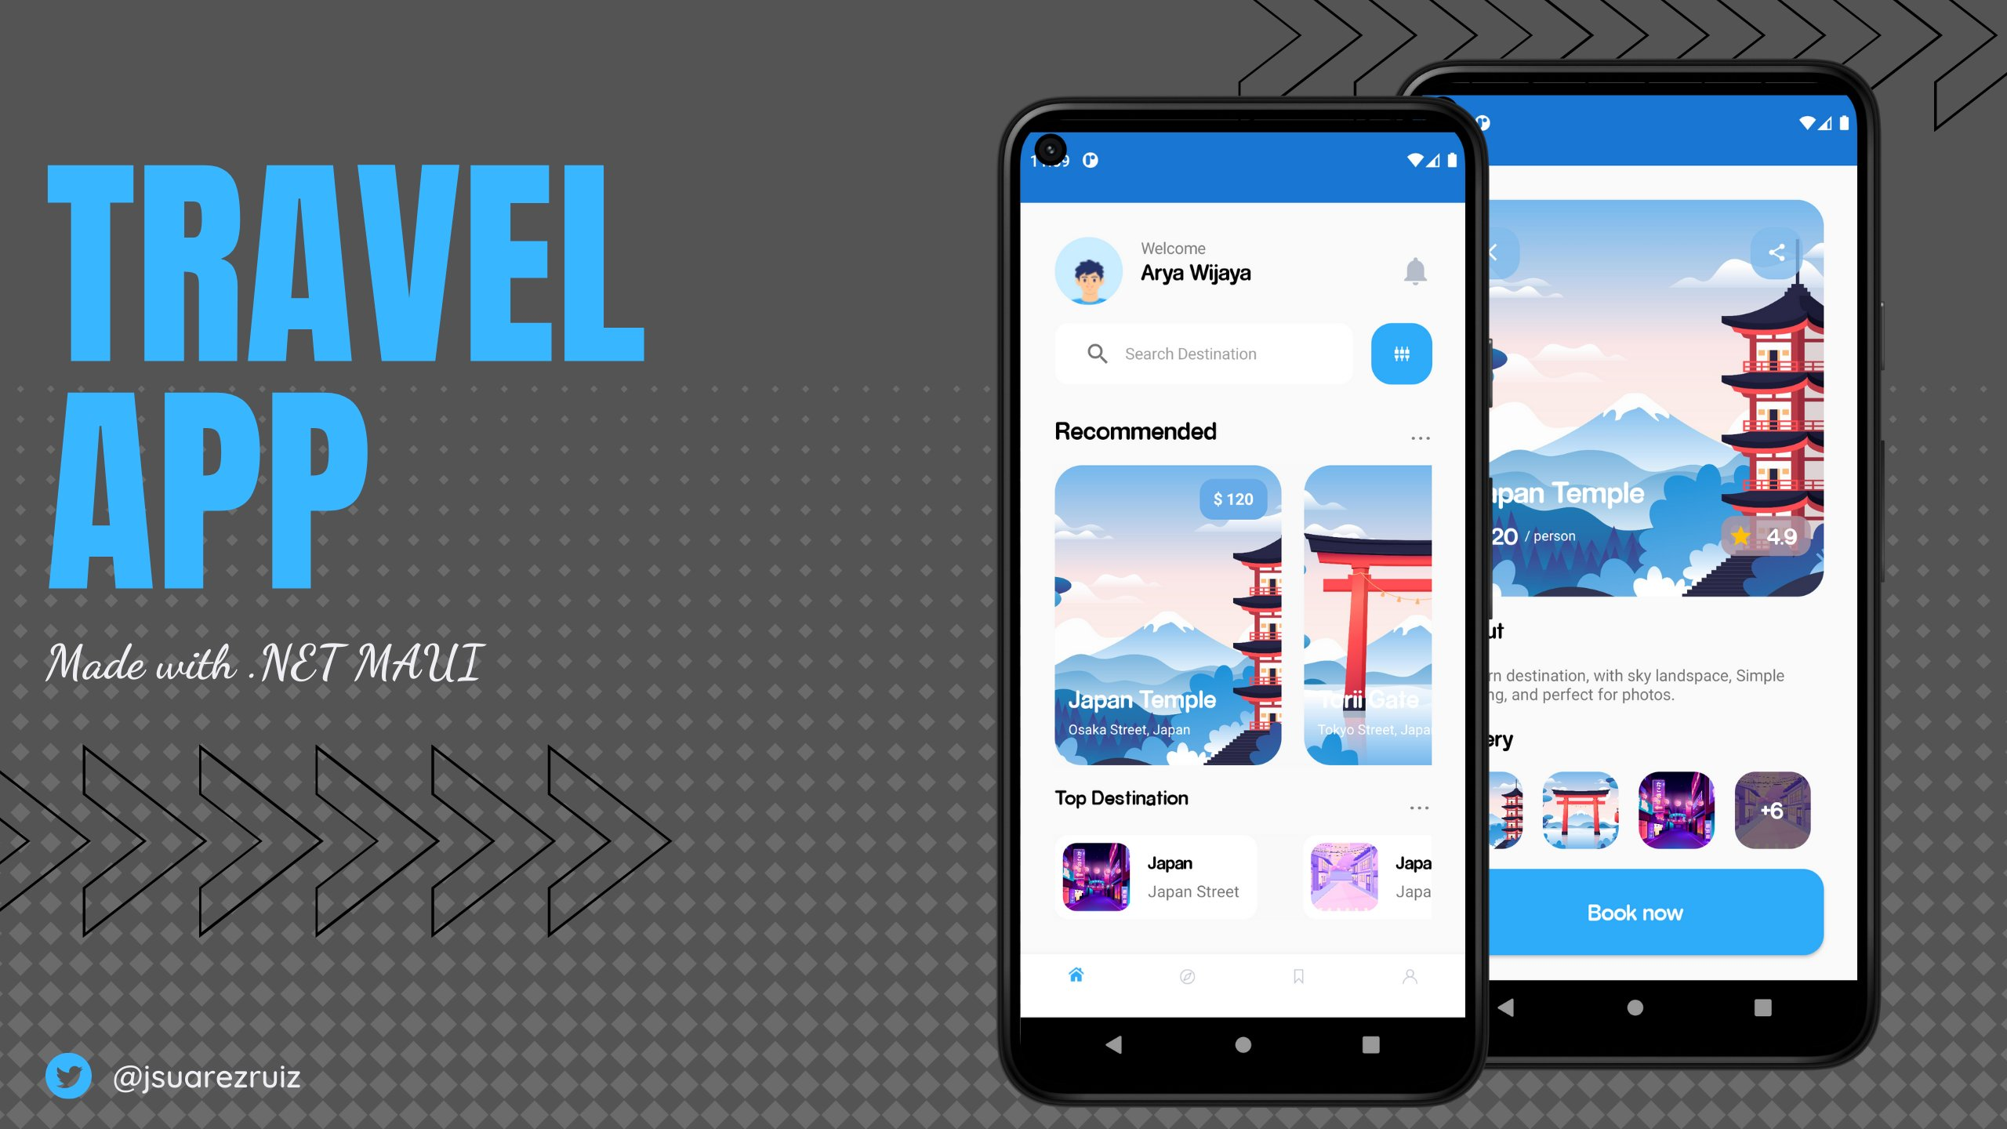

Slide 29
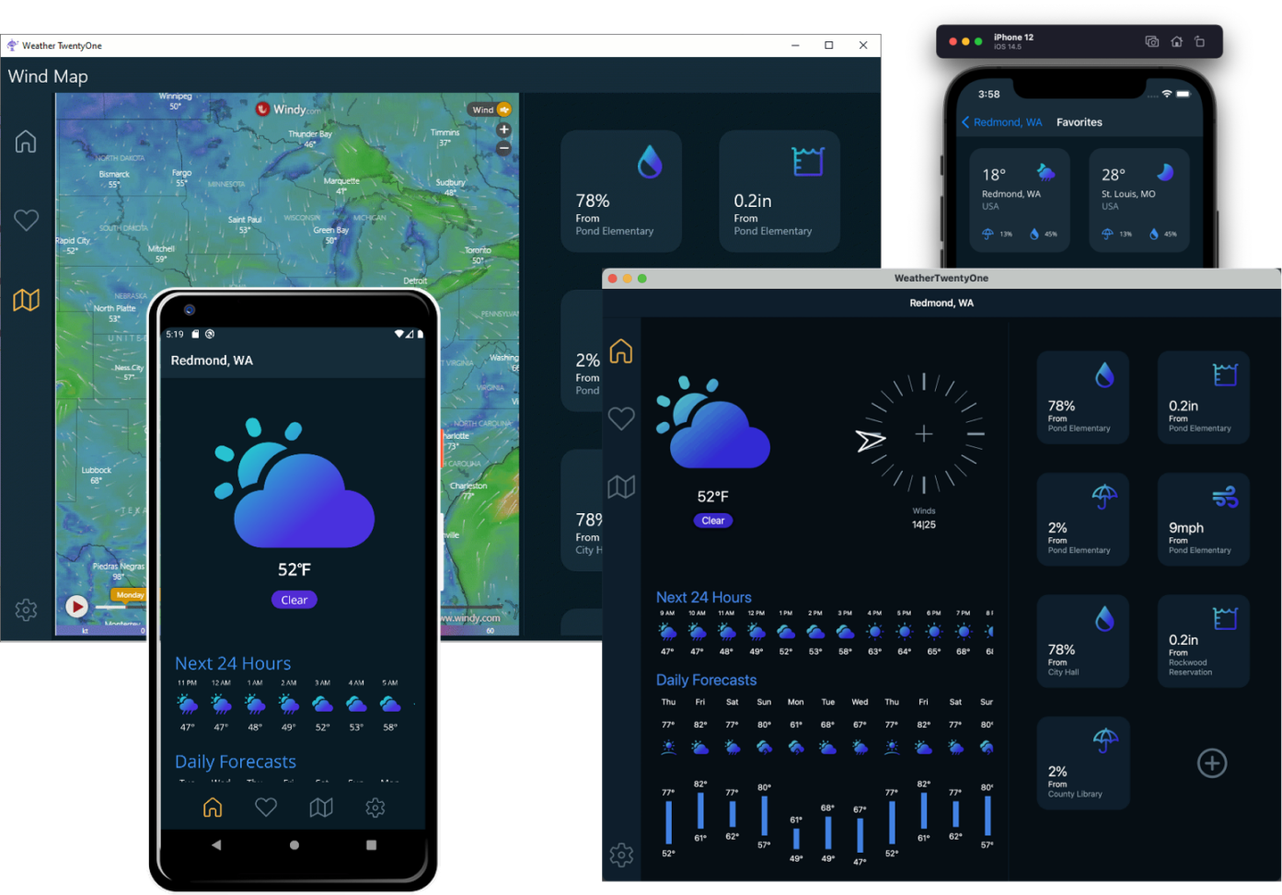

Slide 30




.NET MAUI
.NET 6
Cross-platform, native UI
Single project system, single codebase
Deploy to multiple devices, mobile & desktop
General availability early this year
.NET MAUI
WinUI
Mac Catalyst
iOS
Android
macOS
iOS
github.com/dotnet/maui

Slide 31
What about web developers?

Slide 32
.NET brings rich choice for developers and development teams
BLAZOR
BLAZOR + MAUI
MAUI
WinForms, WPF
Reach
Power
Site
PWA
Electron, CEF
Native App
with WebView
Native App
Web
Hybrid
Native

Slide 33



.NET is flexible. You have choices.
Blazor Server
Blazor WebAssembly
Blazor
Blazor
DOM
SignalR
.NET
Razor Components
DOM
.NET
Razor Components
WebAssembly
Full access to server capabilities
Fast to startup
Code never leaves the server
Supports older browsers & thin clients
Requires persistent connection
Higher UI latency
Runs fully client-side
No required server component
Host as a static site
Can execute offline
Larger download size
Slower runtime performance

Slide 34





Blazor Hybrid apps with .NET MAUI
Blazor
Reuse UI components across native & web
Mix & match web and native UI
Directly access native device functionality
Cross-platform mobile & desktop apps
.NET MAUI
WinUI
Mac Catalyst
iOS
Android
macOS
iOS
github.com/dotnet/maui

Slide 35







Your platform for building anything
Desktop
Web
Cloud
Mobile
Gaming
IoT
AI
.NET

Slide 36

Q&A
Weekly development podcast
mergeconflict.fm
James
Montemagno
Principal Lead PM – Developer Community, Microsoft
motz@microsoft.com
montemagno.com
@JamesMontemagno
/JamesMontemagno

